Slide 1

Statistics and R Q & A Session
With Jason and Alex!

Slide 2
Plan for the Day
5:00pm—5:20pm: Brief review of the main statistical concepts with fun theoretical examples!
5:20-5:40pm: Brief review of statistical tests with code in R (t-tests, CI, ANOVA, regressions)
5:40-6:00pm: Where Jason and Alex go through a simple and clear example to make sure that everyone is fully comfortable with running stats in R
6:00pm-7:00pm: Q and A!!!
Where Jason and Alex are here to answer any of your questions!

Slide 3
Why are we Doing This?
We care!!!
Statistics is EXTREMELY dry….
But it’s important!
As grad students, currently at a class-wise loss when dealing with things that go beyond t-tests…
Problematic because we need to use more “sophisticated” models and tools to address some rather complex problems
Relationships between groups, prediction of an effect given several variables, time series data, etc.

Slide 4
Back To BASICS!
What are “statistics”? They are a collection of quantitative or qualitative characteristics (data) of a A SAMPLE
Statistics is the study of data collection, analysis, presentation, and interpretation.
Descriptive Statistics aim to describe your data’s distribution by its measure of central tendency (i.e., the mean) and dispersion/spread (i.e., variance)
E.g., the mean age of students in a university; the number of Mariah Carey albums one has; the median age of 2nd year PhDs who are Mariah Carey fans, etc.
Inferential Statistics aim to predict an outcome or observation based on your previously obtained data
NOTE: You need to collect A BUNCH of information/data from a group to see if there is a positive or negative relationship with an outcome of interest
E.g., The relationship between season changes and average mood

Slide 5
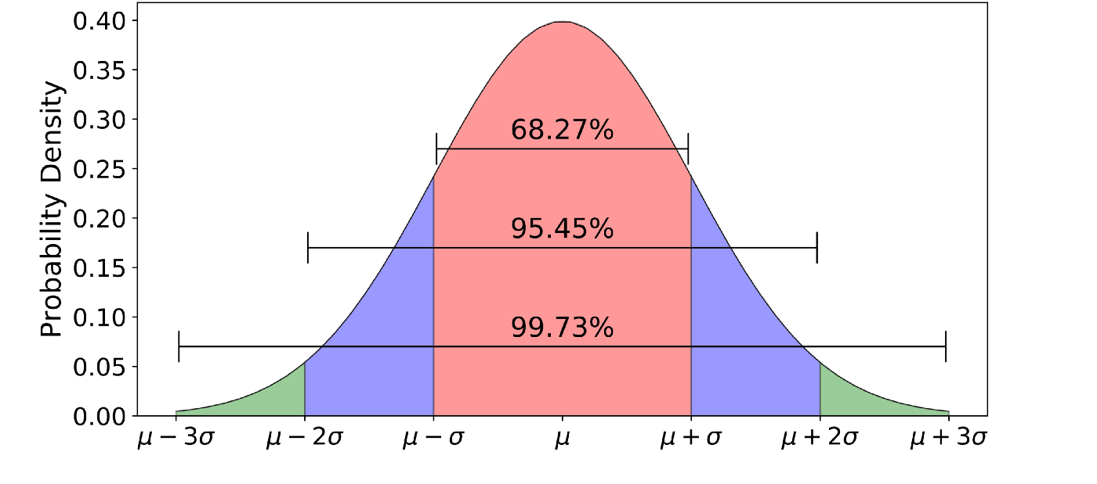

The Normal Distribution
Everything in parametric statistics is based around this bell-shaped curve!
Comes from the observation that it happens A LOT in the world for a bunch of things (repetition of tasks, success at wining at a game, height, etc)
Based on the need to standardize our data to make it comparable (otherwise, everything would be like comparing apples to oranges!)
NOTE:
Z = $\frac{(mean(x) − μ) }{\frac{sd}{\sqrt{n}}}$
Mean = $\sum_{i=1}^{n}{x_{i}} ∗ \frac{1}{n}$
Variance = $\frac{\sum_{i=1}^{n}{{{(x}_{i} −{mean(x}_{i}))}^{2}}}{n − 1}$
sd = $\sqrt{Variance}$

Slide 6
An example…
We would like to compare the mean amount of fish consumed between two groups of people that are from different parts of the world (each has an n = 100). Let’s say that we’re looking at Portugal and Japan.
To make our comparison (a Z-test), we’d need to first standardize our values to make a comparison!
We can do this by making a standardization using information from the population’s mean and standard deviation
If we didn’t do so, our observations would be off! We wouldn’t be considering the spread of our data (based on each population’s own unique information) that we have in both groups!

Slide 7
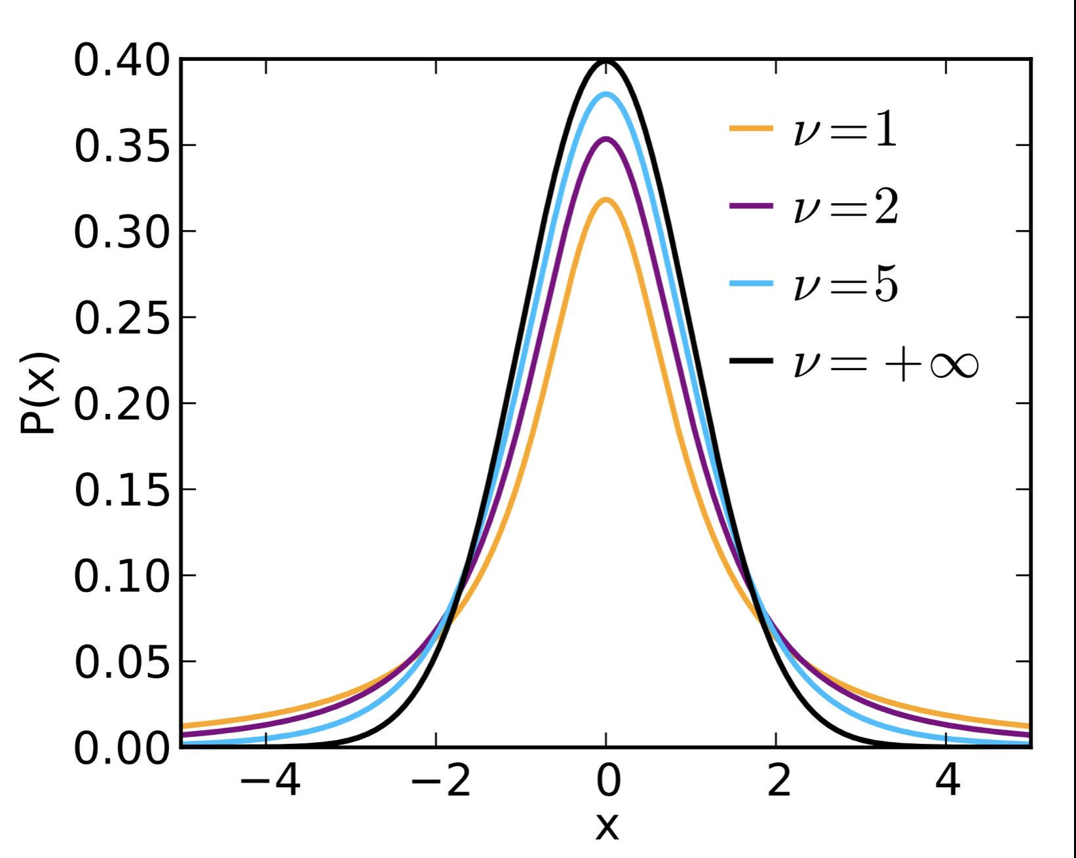
The Student’s T-Distribution
Fun fact: Takes its name from William Sealy Gosset, who used it for the love of Guinness beer in Dublin, Ireland!
NOTE: v = degrees of freedom (n-1)

Slide 8
Let’s say…
We would like to compare the mean number of beers that are consumed between two groups of people from different cities (let’s say the London and Vancouver).
Each has an n = 25.
We can’t make a jump to our normal distribution here (lack of Central Limit Theorem)…but we can use our t-distribution!!!
To make our comparison (a single sample t-test), we’d need to first standardize our values to make a comparison!
But here, we follow a slightly different standardization formula based on A SAMPLE!

Slide 9
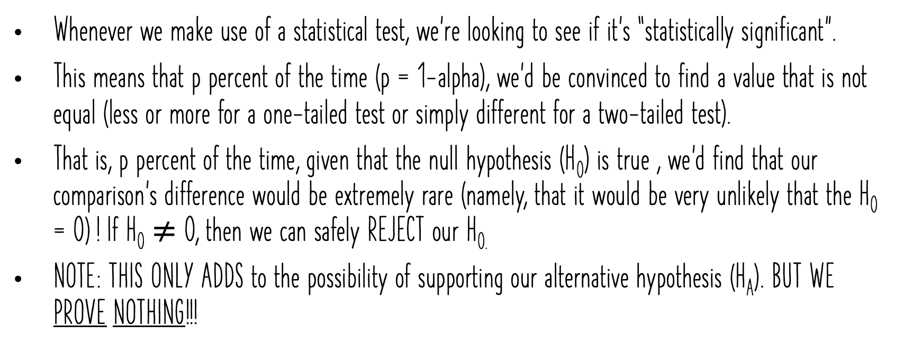
p-Values
Whenever we make use of a statistical test, we’re looking to see if it’s “statistically significant”.
This means that p percent of the time (p = 1-alpha), we’d be convinced to find a value that is not equal (less or more for a one-tailed test or simply different for a two-tailed test).
That is, p percent of the time, given that the null hypothesis (H₀) is true , we’d find that our comparison’s difference would be extremely rare (namely, that it would be very unlikely that the H₀ = 0) ! If H₀ $≠$ 0, then we can safely REJECT our H_{0.}
NOTE: THIS ONLY ADDS to the possibility of supporting our alternative hypothesis (H_{A}). BUT WE PROVE NOTHING!!!

Slide 10
Problem with P-Values (We will argue that they are seriously stupid)
The problem comes from a few things:
Most scientists just use p = 0.95 because! (No explanation; some think that it’s the probability of success…it’s not)
P-values can be seriously affected by sample size (higher sample size, far greater likelihood of finding statistical significance)
Balancing act between Type I (false positives) and Type II (false negatives) errors
Just because something’s significant doesn’t necessarily mean that it’s a MEANINGFUL difference
So…p-values are NOT PERFECT

Slide 11
The awesomeness that is The Confidence Interval!
A really good way to overcome null-hypothesis significance testing (NHST) issues is to always consider confidence intervals.
Confidence intervals = Provides a maximum and minimum value interval that will contain a parameter estimate of choice in X studies out of 100 upon repetition of the experiment.
See: Dance of the confidence intervals = https://www.youtube.com/watch?v=5OL1RqHrZQ8

Slide 12
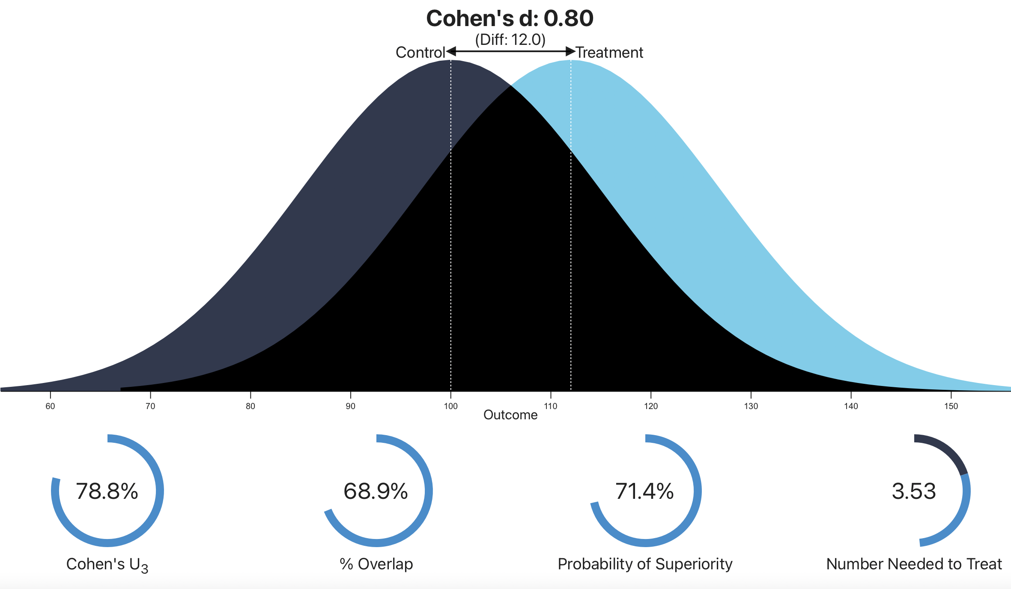

KeEp Calm and calculate effect sizeS!
Another great way to keep null-hypothesis significance testing (NHST) in check is to always consider effect sizes.
Effect size = standardized measure of a relationship between two variables. Examples include:
Pearson Correlation coefficient (r), Beta from a regression (),
Cohen’s d (standardized mean difference)
$\frac{mean difference between groups}{std deviation }$

Slide 13
T-Tests
T-tests assume that your data come from a normal distribution and the observations are sampled independently from one another.
One-sample t-tests test the hypothesis that mean is different than a prespecified u0
Independent-sample t-tests test the hypothesis that the mean difference between both samples is not 0
Paired t-tests are used when the observations are repeated, i.e., each person is sampled twice thus each observation comes in a pair
Unpaired t-tests are used when the observations are independent

Slide 14
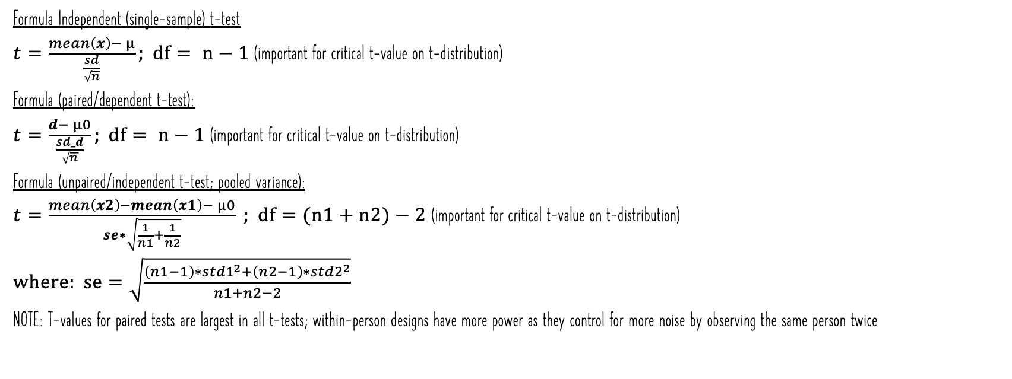
T-Tests
Formula Independent (single-sample) t-test
$t=\frac{mean\left(x\right)− μ}{\frac{sd}{\sqrt{n}}}; df= n−1$ (important for critical t-value on t-distribution)
Formula (paired/dependent t-test):
$t=\frac{d− μ0}{\frac{sd_d}{\sqrt{n}}}; df= n−1$ (important for critical t-value on t-distribution)
Formula (unpaired/independent t-test; pooled variance):
$t=\frac{mean\left(x2\right)−mean\left(x1\right)− μ0}{se∗\sqrt{\frac{1}{n1}+\frac{1}{n2}}} ; df=(n1+n2)−2$(important for critical t-value on t-distribution)
$where: se=\sqrt{\frac{\left(n1−1\right)∗{std1}^{2}+\left(n2−1\right)∗{std2}^{2}}{n1+n2−2}}$
NOTE: T-values for paired tests are largest in all t-tests; within-person designs have more power as they control for more noise by observing the same person twice

Slide 15
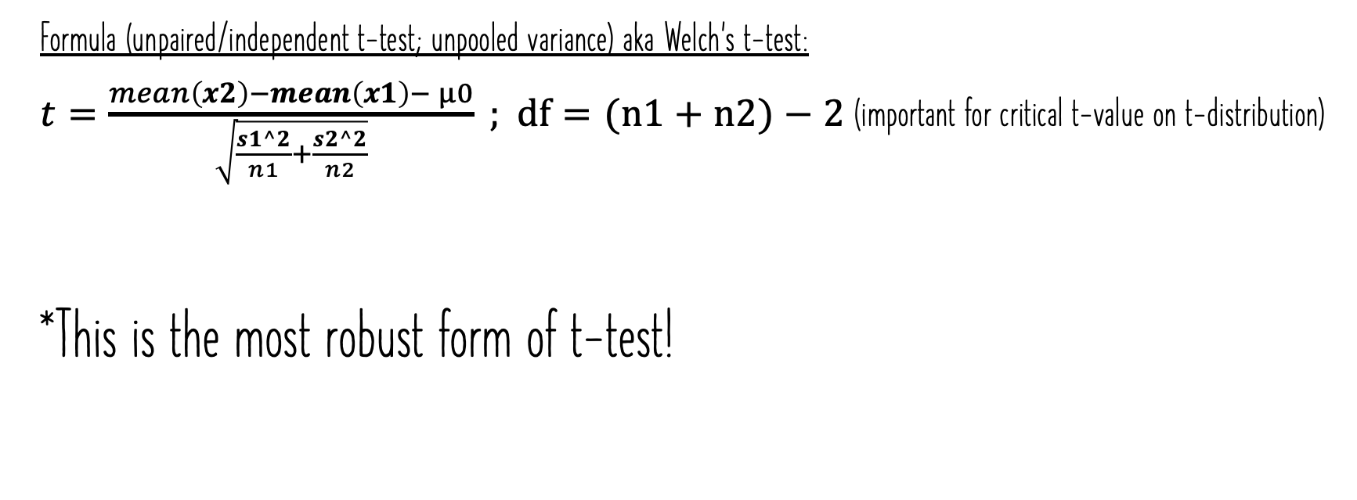
T-Tests
Formula (unpaired/independent t-test; unpooled variance) aka Welch’s t-test:
$t=\frac{mean\left(x2\right)−mean\left(x1\right)− μ0}{\sqrt{\frac{s1^2}{n1}+\frac{s2^2}{n2}}} ; df=(n1+n2)−2$(important for critical t-value on t-distribution)
*This is the most robust form of t-test!

Slide 16
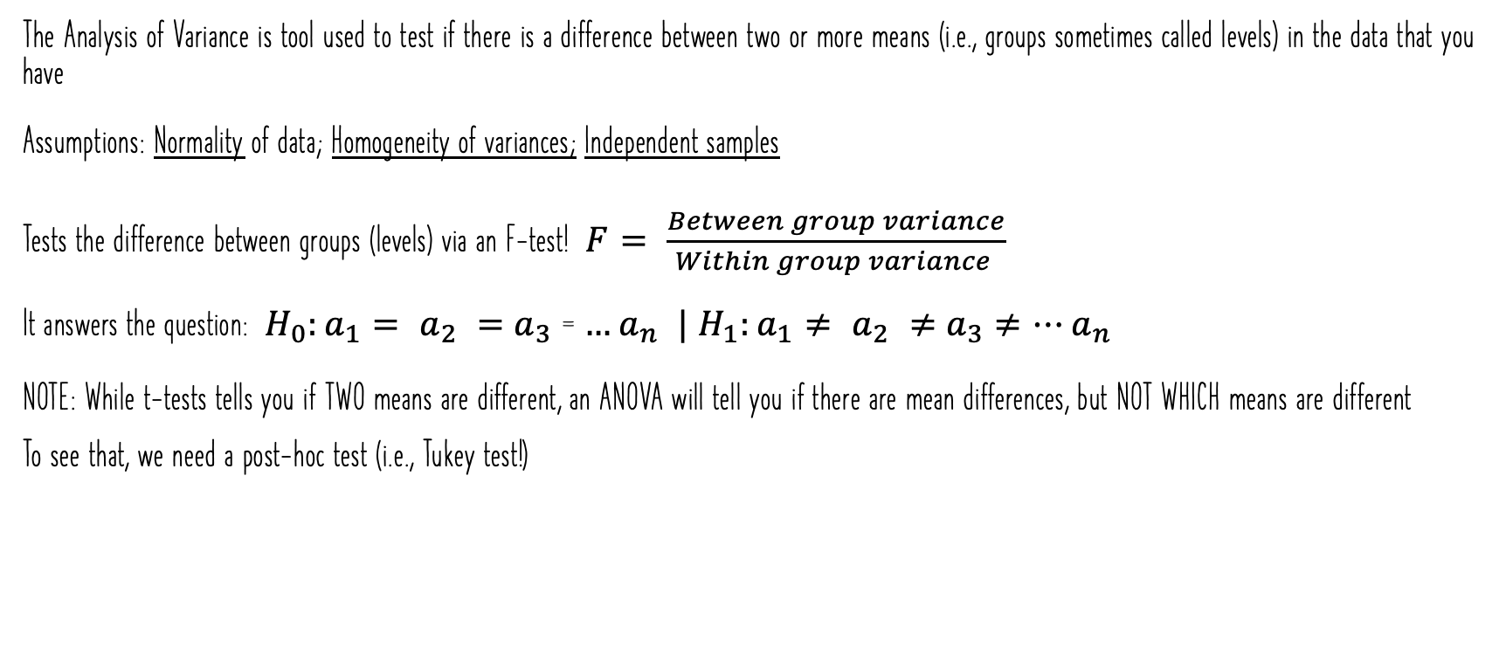
ANOVAs
The Analysis of Variance is tool used to test if there is a difference between two or more means (i.e., groups sometimes called levels) in the data that you have
Assumptions: Normality of data; Homogeneity of variances; Independent samples
Tests the difference between groups (levels) via an F-test! $F= \frac{Between group variance}{Within group variance }$
It answers the question: $H_{0}:a_{1}= a_{2} =$ $a_{3}$= $…a_{n} |$ $H_{1}:a_{1}≠ a_{2} ≠$ $a_{3}≠…a_{n}$
NOTE: While t-tests tells you if TWO means are different, an ANOVA will tell you if there are mean differences, but NOT WHICH means are different To see that, we need a post-hoc test (i.e., Tukey test!)

Slide 17
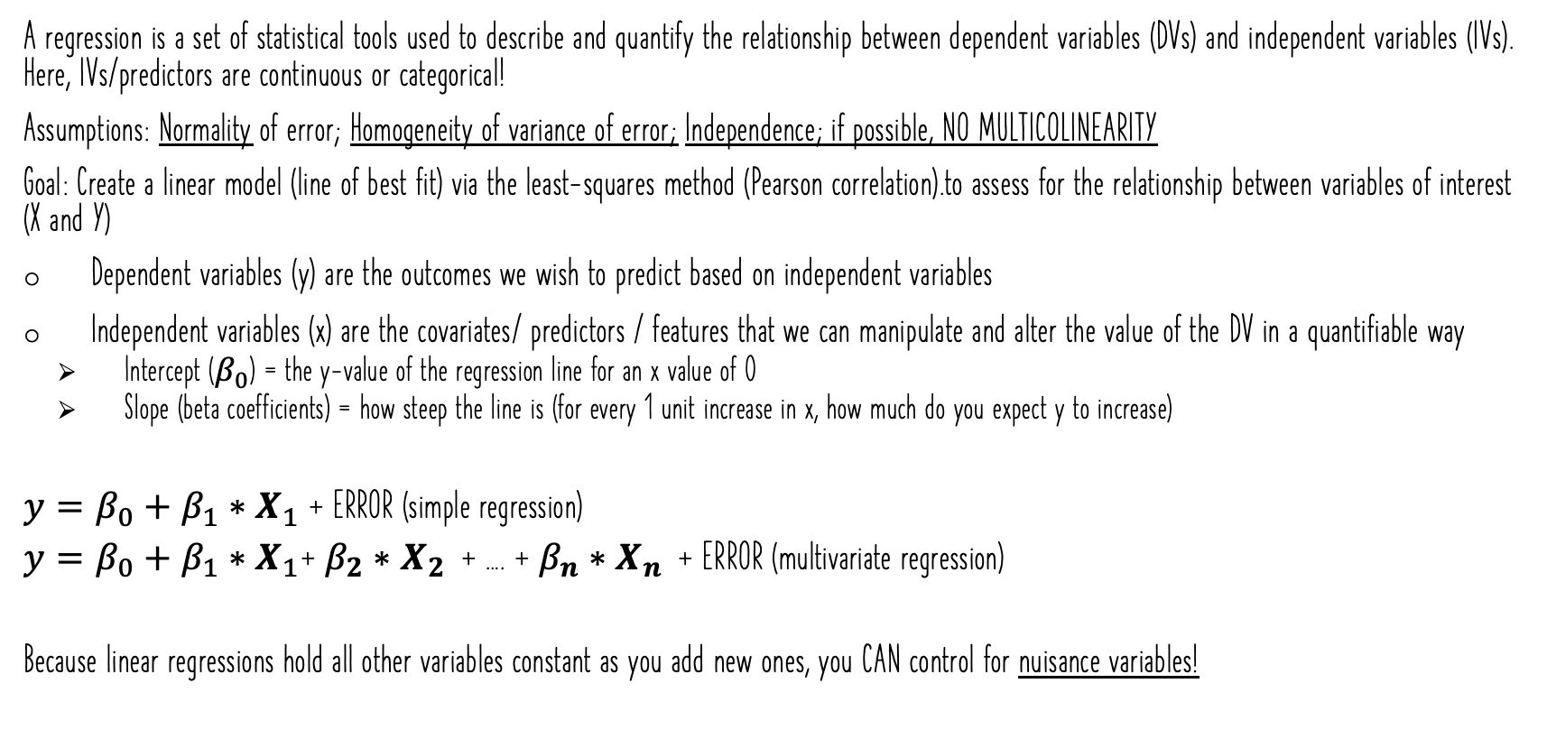
Regressions
A regression is a set of statistical tools used to describe and quantify the relationship between dependent variables (DVs) and independent variables (IVs). Here, IVs/predictors are continuous or categorical!
Assumptions: Normality of error; Homogeneity of variance of error; Independence; if possible, NO MULTICOLINEARITY
Goal: Create a linear model (line of best fit) via the least-squares method (Pearson correlation).to assess for the relationship between variables of interest (X and Y)
Dependent variables (y) are the outcomes we wish to predict based on independent variables
Independent variables (x) are the covariates/ predictors / features that we can manipulate and alter the value of the DV in a quantifiable way
Intercept ($β_{0}$) = the y-value of the regression line for an x value of 0
Slope (beta coefficients) = how steep the line is (for every 1 unit increase in x, how much do you expect y to increase)
$y=β_{0}+β_{1}∗X_{1}$ + ERROR (simple regression)
$y=β_{0}+β_{1}∗X_{1}$+ $β_{2}∗X_{2 }$ + …. + $β_{n}∗X_{n }$ + ERROR (multivariate regression)
Because linear regressions hold all other variables constant as you add new ones, you CAN control for nuisance variables!

Slide 18

Why we like regressions (They're the same as ANOVA!)
Remember: ANOVAs and Linear regressions are not so different from one another
In fact, ANOVAs are just a special case of a regression where the IVs are categorical in nature (that is, we can define them via DUMMY CODING or EFFECT Coding!)
In our regression model, the intercept $β_{0}$ is the mean of y for all conditions when they are 0 (i.e., Low--easy) for dummy coding; grand mean for effect coding
The slope $β_{1}$ is the difference between high and how Attention for the easy task in dummy coding; across difficulties for effect coding
The slope $β_{2}$ is the difference between the easy and difficult task for low attention in dummy coding; across difficulties for effect coding
Attention (X1) | Difficulty (X2) | Coding Attention | Coding Difficulty
High | easy | 1 | 0
Low | easy | 0 | 0
High | easy | 1 | 0
High | hard | 0 | 1
Low | hard | 1 | 1
High | hard | 0 | 1
Attention (X1) | Difficulty (X2) | Coding Attention | Coding Difficulty
High | easy | 1 | -1
Low | easy | -1 | -1
High | easy | 1 | -1
High | hard | 1 | 1
Low | hard | -1 | 1
High | hard | 1 | 1

Slide 19
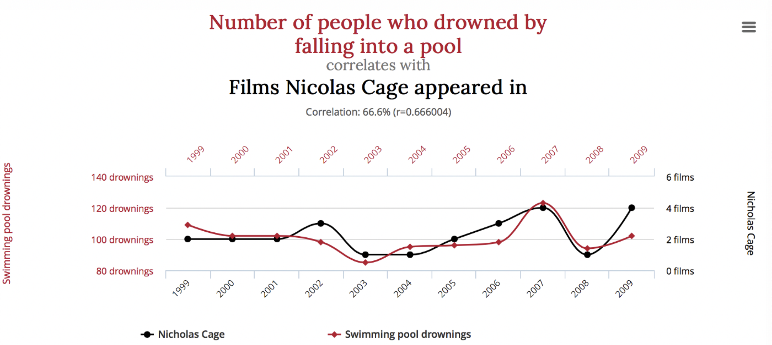
Correlation is NOT CAUSATION!

Slide 20
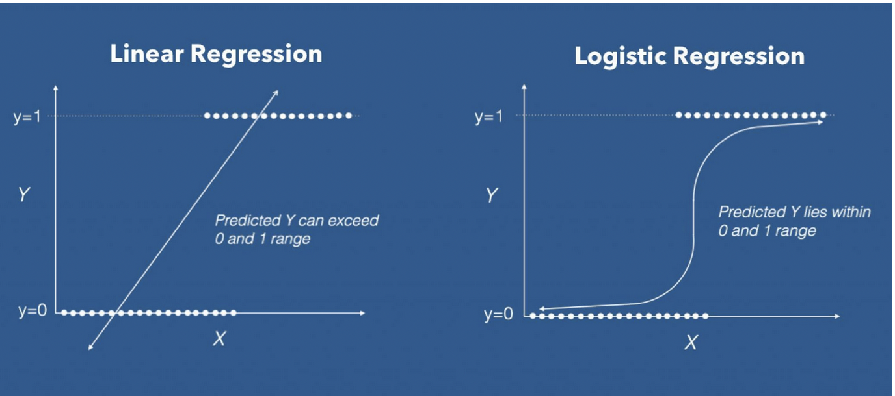
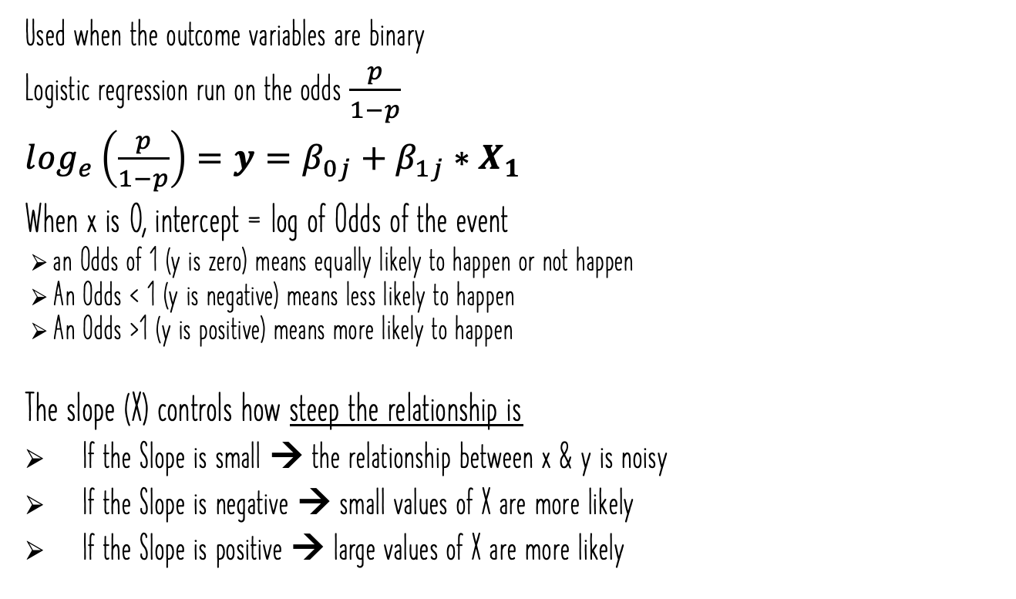
Logistic Regression
Used when the outcome variables are binary
Logistic regression run on the odds $\frac{p}{1−p}$
$\log_{e}\left(\frac{p}{1−p}\right)=y=β_{0j}+β_{1j}∗X_{1}$
When x is 0, intercept = log of Odds of the event
an Odds of 1 (y is zero) means equally likely to happen or not happen
An Odds < 1 (y is negative) means less likely to happen
An Odds >1 (y is positive) means more likely to happen
The slope (X) controls how steep the relationship is
If the Slope is small → the relationship between x & y is noisy
If the Slope is negative → small values of X are more likely
If the Slope is positive → large values of X are more likely

Slide 21
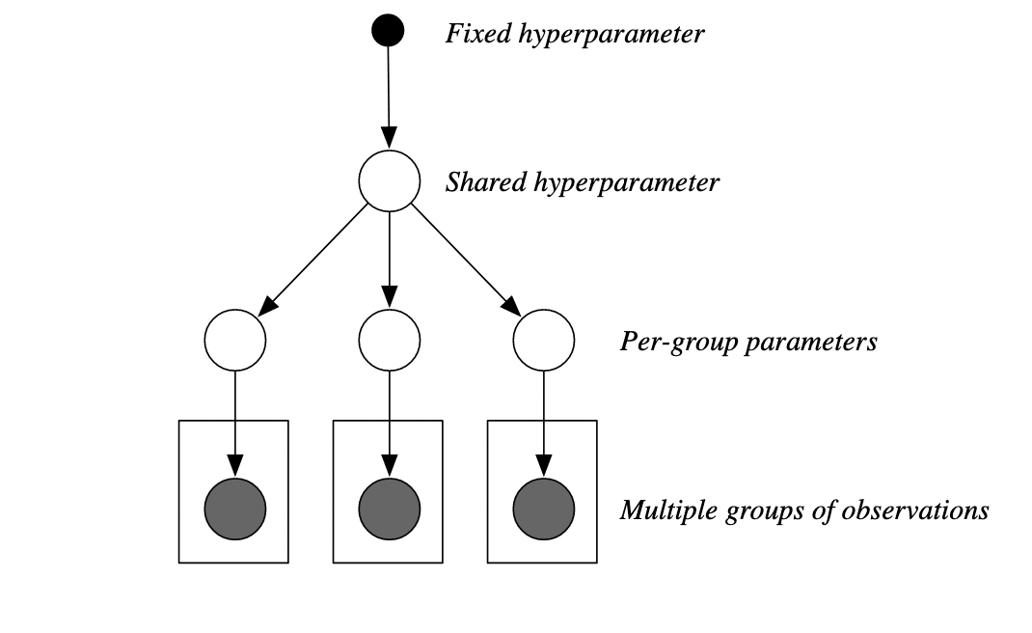
Hierarchical Modeling
Used when your data has a defined pre-established structure (e.g., your variables are nested)
Predictors are NOT INDEPDENDENT for repeated measure designs where participants see multiple experimental conditions!
Considering the correlated structure of your observations to better deal with noise and lets you make better predictions/estimates of your effects
This is achieved by allowing intercepts or slopes to vary as a function of the levels/nests within your data
All models have both fixed and random effects
Fixed effects — assume you have every desired level of variable (e.g., experimental condition)
WE MANIPULATE THESE
Random effects — assume you do not have every possible level you wish to test (e.g., participant)
SOURCES OF VARIATION that we DON’T WANT (ERROR)
Notes:
For example, allowing every person in your sample to get a different intercept accounts for the fact that people have differences in response times, but fixing the slope of the regression lets you test the effect across your conditions

Slide 22
How to fit a model
Best way: Try to reduce error
Try to improve the amount of R² in your models (be careful here as having more variables will automatically increase R²)!
Use computational tools to reduce measures of AIC (Akaike information criterion) and BIC (Bayesian information criterion) to balance the fit of the model as well as parsimony

Slide 23
Non-Parametric Statistics
In stats there are some tests that are non-parametric; the test does not require assuming a specific model or distribution for your data
These tests are used when you do not meet the parameters for a specific distribution or do not know the distribution of your data!
You can make many of the common statistics non-distributional via permutations (e.g., permutation t-test)!
Permutations build a null distribution (null hypothesis is true) based on your observations
Assumption: randomly shuffling your data will void the effect of interest.
Thus, you can measure how surprising the effect you observe is compared to your computed null distribution

Slide 24

But Remember: IN CASE all hell breaks lose, We Pick ourselves up by the bootstraps with Bootstrapping!

Slide 25
bootstrapping
We use bootstrapping to get a measure of uncertainty around an estimate (e.g., CI)
Bootstrapping resamples your data, but bootstrapping requires replacement
It is often used to calculate the error associated to an estimate, effect, or performance of an algorithm and allows you to know if one given data point is driving the effect you see
The computed average for each bootstrap will allow you to get an idea of what range of values you could expect given your data
VERY ROBUST

Slide 26
A Simple Example – LET’S GET CODING!!!
Now, Alex and Jason will take you through a simple example of how you can use these forms of tests to analyze a dataset!
Then, we’ll get cracking on your questions!
If you need any help, please be sure to come back to these slides to brush up on your theory!

Slide 27
Resources
https://towardsdatascience.com/understanding-the-68-95-99-7-rule-for-a-normal-distribution-b7b7cbf760c2
https://en.wikipedia.org/wiki/Student%27s_t-distribution#/media/File:Student_t_pdf.svg
https://rpsychologist.com/cohend/
https://learningstatisticswithr.com/book/part-i-background.html
https://book.stat420.org/simple-linear-regression.html
https://www.geo.fu-berlin.de/en/v/soga/Basics-of-statistics/Logistic-Regression/Logistic-Regression-in-R---An-Example/index.html
https://www.tidyverse.org
https://www.cs.princeton.edu/courses/archive/fall11/cos597C/lectures/hierarchical-models.pdf
https://towardsdatascience.com/introduction-to-hierarchical-modeling-a5c7b2ebb1ca
https://www.datacamp.com/community/tutorials/pca-analysis-r
https://www.geeksforgeeks.org/principal-component-analysis-with-r-programming/
https://towardsdatascience.com/partial-least-squares-f4e6714452a
https://search.r-project.org/CRAN/refmans/DescTools/html/PostHocTest.html
https://cran.r-project.org/web/packages/pls/vignettes/pls-manual.pdf

